Slide 1

Course Title: Business Analysis Assessments (DATA 1203) Assignment 3: Data Visualization (A Case Study of Tulip Executive Health Group)
Student Name: Lateef Amidu
Student ID: 100892571

Slide 2
Audience Analysis
The audience for this presentation report is the senior management team of Tulip Health Group, comprising of highly experienced VPs and Directors who are responsible for making informed, critical business decisions that impact the company's future
The senior management team should have a clear understanding of the company's current state, including its mission, vision, financial heath, operational capabilities, as well as growth plan for the Tulip Group
This presentation report aim to identify useful trends and provide valuable insights that the senior management team could use in making data-driven decisions
Due to the caliber of these senior managers, the report’s tone is professional, objective, and persuasive.
Although the dataset used for this report contains relevant features for this study, more data will be needed to some more pertinent questions about Tulip Group such as patient satisfaction, waiting time, etc.
Limited data are available on current status of the healthcare industry, regulatory challenges, which could limit the audience’s abilities to craft growth strategies and design viable solutions to identified problems
Overall, the senior management team will be able to make data-centric decisions for Tulip Health Group’s in terms of business growth, revenue generation, expansion opportunities at the end of this presentation report

Slide 3
Data Analysis
The Tulip Executive Health Group dataset for the business year 2021 used for this project is of low quality as it contains many errors which could affect the inference made from the data analysis. If the errors are not properly handled, the analysis results could be misleading to the senior management team and critically affect the business decisions made using such results. The table below summarizes errors in the data and recommended actions to correct the identified errors:
Errors | Description of Errors | Action to be Taken
Presence of Missing Values | Many blank cells are in the data, e.g., Family ID, Family Member, Annual Fee, Clinician, Membership Level have as high as 270 missing values, etc. | Treat the empty cells in the Family Member column as ‘Principal’ of the family Replace empty cells for clinician with another qualified therapist (Stokes in this case) Remove member level and position features Replace missing annual fee with mean =2500
Spelling Errors | Some cells contain wrong spellings which the analysis tool will identify as separate category, e.g.,Caridology, Coodination, Genticts, Phyio, Phyiso, Aessessment,Cooridinator,Physican, Siliver | Correct each of the identified words appropriately to align with other categories
Data Imputation Errors | Some unrealistic data were identified in the dataset, e.g., some patients (Husband, Wife, Partner) are less than 2 years old which is impossible | Delete the birthdate and Family Member features as both are not reliable. Remove the company position feature

Slide 4
Key Performance Questions that the Data can Answer
From the available variables/features of the Tulip dataset, below are some Key Performance Questions (KPQs) that can be answered by analyzing the available business data in 2021:
What is the total service fee?
What is the total number of patients?
What is the total number of patient visits?
What is the service fee per patient?
What is the patient-to-clinician ratio?

Slide 5
Key Performance Questions (KPQs) that the Data CANNOT Answer
KPQs Data Cannot Answer
Recommended Data that should be Collected
From the available variables/features of the Tulip dataset, below are some Key Performance Questions (KPQs) that CANNOT be answered by analyzing the available business data in 2021:
What is the employee churn rate?
What is the patient referral rate?
What is the patient satisfaction score?
What is the total operating cost of running Tulip?
What is the waiting time to attend to a patient via virtual media or in-person?
What is the service time to attend to a patient via virtual media or in-person?
In order to answer the above questions, the following additional data should be collected:
Date of employment, date of resignation and number of years working with the company
Ask patient if they have referred anyone to Tulip before, number of people they referred, how often, etc.
Customer ratings of Tulip service on various parameters such as service delivery, response time, etc.
Operating cost, salaries, direct and indirect costs, outsourcing costs, capital investments data are needed Number of minutes or hours between a patient’s arrival and time being attended
Number of minutes used in attending to each patients
For the last 2 points above, data should be collected on the type of service, hours of the day patient visit, and week day so that various categorization could be done to uncover any interesting trends or patterns

Slide 6
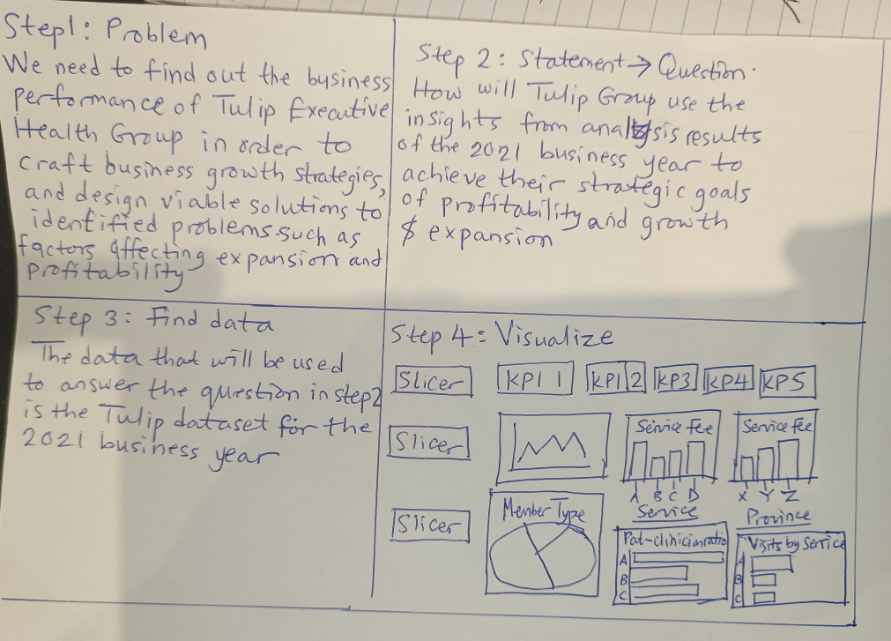
Data Storyboard
Using the data story telling template, below is a sketch of a data storyboard for analyzing the Tulip dataset

Slide 7
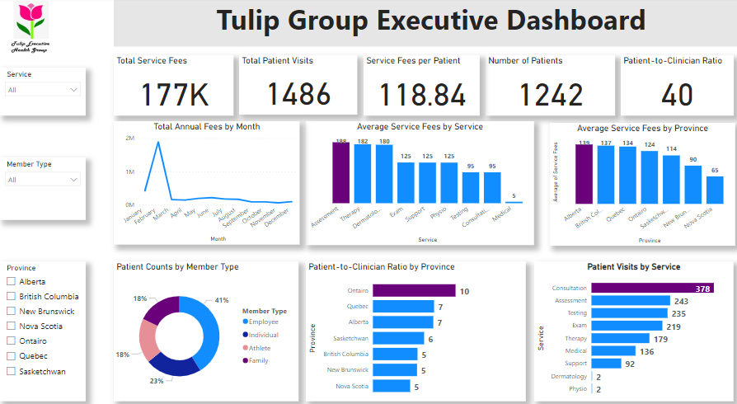
Executive Dashboard Using PowerBI

Slide 8
Instructions for your Executive Dashboard
The Executive dashboard for the Tulip Executive Health Group contains several key performance indicators (KPIs) and charts representing the performance of Tulip in the year 2021, across the various provinces, member type and service offered. Below are instructions on how to interpret and read the dashboard:
There are 5 card visuals on the dashboard, each representing different KPI. The first card titled “Total Service Fees” showed total amount Tulip earned from repeating patient visits for various services. The “Total Patient Visits” showed total number of visits by all patients whether virtual or in-person. The “service fees per patient“ measures average fee a patient is charged per service. Number of patients count the unique number of people that patronized Tulip. The patient-to-clinician ratio is the ratio of patients to clinicians at Tulip and there are 40 patients to 1 clinician in the entire tulip Group.
The line graph shows the total annual fees earned from patients for different months in 2021. February recorded highest annual fee significantly greater than all other months
The “Average Service fees by service” and “Average Service fees by province” column charts show how much was charged on average for the various serviced offered by Tulip and Assessment recorded the highest service fee while Alberta charges the highest service fee.
The pie chart shows the member type of patients (employee/individual/athlete/family).Most are employees
The “patient-to-clinician ratio by province” chart shows how many patients are attended to by 1 ratio in each province while the “patient visits by service” chart show total number of visits for the various services Tulip offered. Ontario has the highest patient-to-clinician ratio (10) while most patients visit Tulip for consultations
The slicers at the left side are used for filtering the service, member type, and province

Slide 9
Appendix
Below is a list of the design techniques utilized in the construction of the Executive Dashboard with powerBI, using the provided Tulip business data for 2021:
Variety: 6 various chart types, 5 colors and shape were used in the construction of the executive dashboard, thereby satisfying the variety design technique
Repetition: Visuals such as cards, slicers, column bar chart, horizontal bar charts were utilized in presenting the relationship among the variables or features of the Tulip data set
Emphasis: Some chart attributes such as increasing the font sizes on the card visuals, using different colors to differentiate the highest value on the vertical and horizontal bar charts, were done with the aim of drawing the directors and VPs attention to those vital information
Pattern: In the dashboard, the tallest bars was filled with purple color and this pattern was consistently maintained throughout the report so as to quickly capture the audience attention away from the other bars
Balance: The layout and design of the dashboard contains an appropriate blend of similar color, shape, font and font sizes, shadow effect, equal alignment of charts horizontally on the dashboard

Slide 10
THANK YOU

